Slide 1
Supervised Learning

Slide 2
An example application
An emergency room in a hospital measures 17 variables (e.g., blood pressure, age, etc) of newly admitted patients.
A decision is needed: whether to put a new patient in an intensive-care unit.
Due to the high cost of ICU, those patients who may survive less than a month are given higher priority.
Problem: to predict high-risk patients and discriminate them from low-risk patients.

Slide 3
Another application
A credit card company receives thousands of applications for new cards. Each application contains information about an applicant,
  age
  Marital status
  annual salary
  outstanding debts
  credit rating
  etc.
Problem: to decide whether an application should approved, or to classify applications into two categories, approved and not approved.

Slide 4
Machine learning and our focus
Like human learning from past experiences.
A computer does not have “experiences”.
A computer system learns from data, which represent some “past experiences” of an application domain.
Our focus: learn a target function that can be used to predict the values of a discrete class attribute, e.g., approve or not-approved, and high-risk or low risk.
The task is commonly called: Supervised learning, classification, or inductive learning.

Slide 5
The data and the goal
Data: A set of data records (also called examples, instances or cases) described by
  k attributes: A₁, A₂, … A_{k}.
  a class: Each example is labelled with a pre-defined class.
Goal: To learn a classification model from the data that can be used to predict the classes of new (future, or test) cases/instances.
Notes:
Induction is different from deduction and DBMS does not not support induction;
The result of induction is higher-level information or knowledge: general statements about data
There are many approaches. Refer to the lecture notes for CS3244 available at the Co-Op.
We focus on three approaches here, other examples:
Other approaches
Instance-based learning
other neural networks
Concept learning (Version space, Focus, Aq11, …)
Genetic algorithms
Reinforcement learning

Slide 6
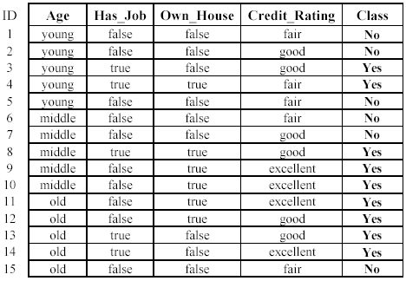
An example: data (loan application)
Approved or not

Slide 7
An example: the learning task
Learn a classification model from the data
Use the model to classify future loan applications into
  Yes (approved) and
  No (not approved)
What is the class for following case/instance?

Slide 8
Supervised vs. unsupervised Learning
Supervised learning: classification is seen as supervised learning from examples.
  Supervision: The data (observations, measurements, etc.) are labeled with pre-defined classes. It is like that a “teacher” gives the classes (supervision).
  Test data are classified into these classes too.
Unsupervised learning (clustering)
  Class labels of the data are unknown
  Given a set of data, the task is to establish the existence of classes or clusters in the data

Slide 9
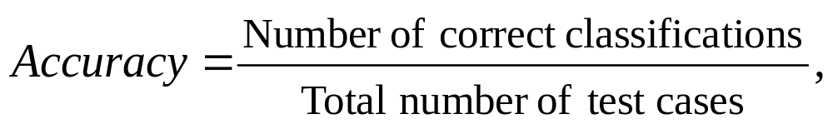
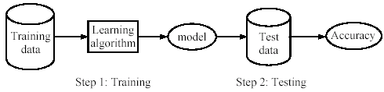
Supervised learning process: two steps
Learning (training): Learn a model using the training data
Testing: Test the model using unseen test data to assess the model accuracy

Slide 10
What do we mean by learning?
Given
  a data set D,
  a task T, and
  a performance measure M,
a computer system is said to learn from D to perform the task T if after learning the system’s performance on T improves as measured by M.
In other words, the learned model helps the system to perform T better as compared to no learning.

Slide 11
An example
Data: Loan application data
Task: Predict whether a loan should be approved or not.
Performance measure: accuracy.
No learning: classify all future applications (test data) to the majority class (i.e., Yes):
Accuracy = 9/15 = 60%.
We can do better than 60% with learning.

Slide 12
Fundamental assumption of learning
Assumption: The distribution of training examples is identical to the distribution of test examples (including future unseen examples).
In practice, this assumption is often violated to certain degree.
Strong violations will clearly result in poor classification accuracy.
To achieve good accuracy on the test data, training examples must be sufficiently representative of the test data.

Slide 13
Decision Tree: Introduction
Decision tree learning is one of the most widely used techniques for classification.
  Its classification accuracy is competitive with other methods, and
  it is very efficient.
The classification model is a tree, called decision tree.

Slide 14
The loan data (reproduced)
Approved or not

Slide 15
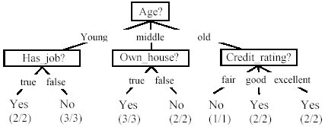
A decision tree from the loan data
Decision nodes and leaf nodes (classes)

Slide 16
Use the decision tree
No

Slide 17
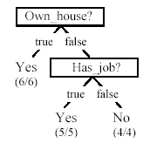
Is the decision tree unique?
No. Here is a simpler tree.
We want smaller tree and accurate tree.
  Easy to understand and perform better.
Finding the best tree is hard.
All current tree building algorithms are experiential algorithms

Slide 18

From a decision tree to a set of rules
A decision tree can be converted to a set of rules
Each path from the root to a leaf is a rule.

Slide 19
Algorithm for decision tree learning
Basic algorithm (a greedy divide-and-conquer algorithm)
  Assume attributes are categorical now (continuous attributes can be handled too)
  Tree is constructed in a top-down recursive manner
  At start, all the training examples are at the root
  Examples are partitioned recursively based on selected attributes
  Attributes are selected on the basis of an impurity function (e.g., information gain)
Conditions for stopping partitioning
  All examples for a given node belong to the same class
  There are no remaining attributes for further partitioning – majority class is the leaf
  There are no examples left

Slide 20
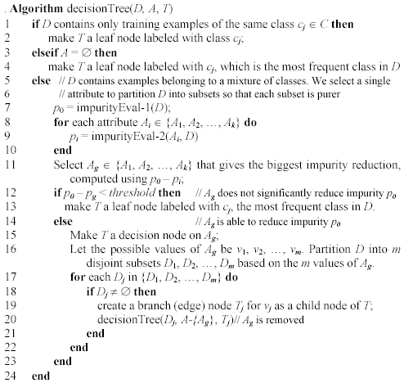
Decision tree learning algorithm

Slide 21
Choose an attribute to partition data
The key to building a decision tree - which attribute to choose in order to branch.
The objective is to reduce impurity or uncertainty in data as much as possible.
  A subset of data is pure if all instances belong to the same class.
The experiential in C4.5 is to choose the attribute with the maximum Information Gain or Gain Ratio based on information theory.

Slide 22
The loan data (reproduced)
Approved or not

Slide 23
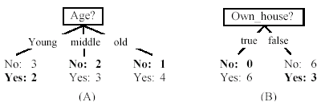
Two possible roots, which is better?
Fig. (B) seems to be better.

Slide 24
Information theory
Information theory provides a mathematical basis for measuring the information content.
To understand the idea of information, think about it as providing the answer to a question, for example, whether a coin will come up heads.
  If one already has a good guess about the answer, then the actual answer is less informative.
  If one already knows that the coin is rigged so that it will come with heads with probability 0.99, then a message (advanced information) about the actual outcome of a flip is worth less than it would be for a honest coin (50-50).

Slide 25
Information theory (cont …)
For a fair (honest) coin, you have no information, and you are willing to pay more (say in terms of $) for advanced information - less you know, the more valuable the information.
Information theory uses this same intuition, but instead of measuring the value for information in dollars, it measures information contents in bits.
One bit of information is enough to answer a yes/no question about which one has no idea, such as the flip of a fair coin

Slide 26
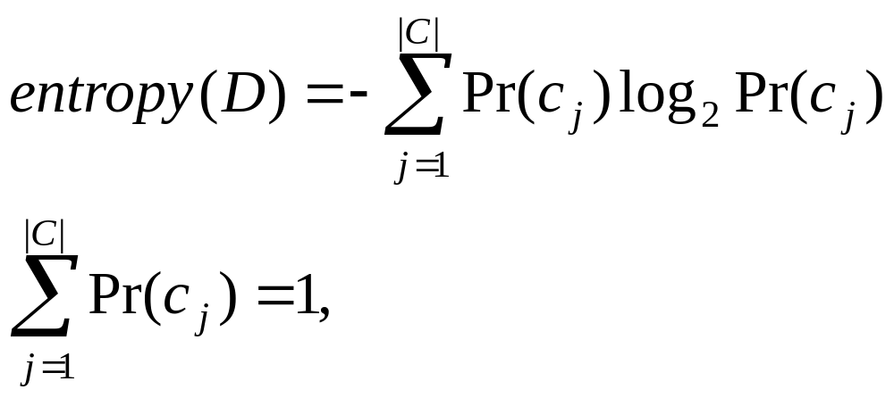
Information theory: Entropy measure
The entropy formula,
Pr(c_{j}) is the probability of class c_{j} in data set D
We use entropy as a measure of impurity or disorder of data set D. (Or, a measure of information in a tree)

Slide 27
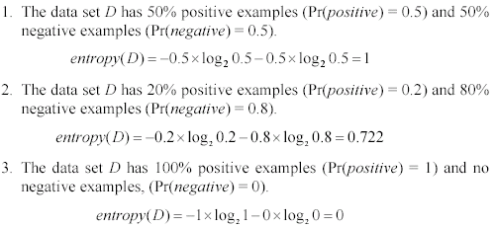
Entropy measure: let us get a feeling
As the data become purer and purer, the entropy value becomes smaller and smaller. This is useful to us!

Slide 28

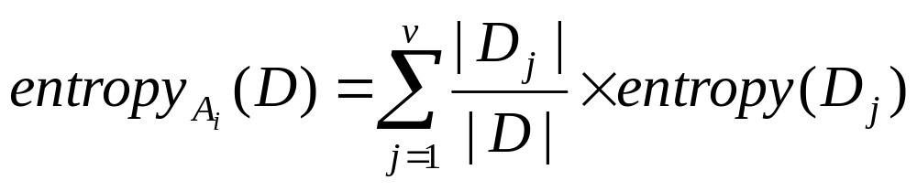
Information gain
Given a set of examples D, we first compute its entropy:
If we make attribute A_{i}, with v values, the root of the current tree, this will partition D into v subsets D₁, D₂ …, D_{v} . The expected entropy if A_{i} is used as the current root:

Slide 29
Information gain (cont …)
Information gained by selecting attribute A_{i} to branch or to partition the data is
We choose the attribute with the highest gain to branch/split the current tree.

Slide 30
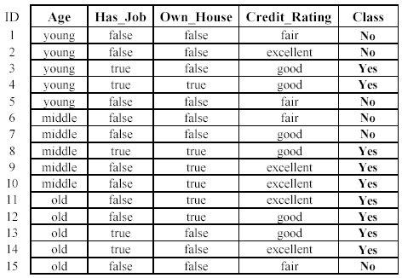
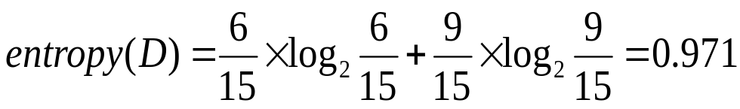
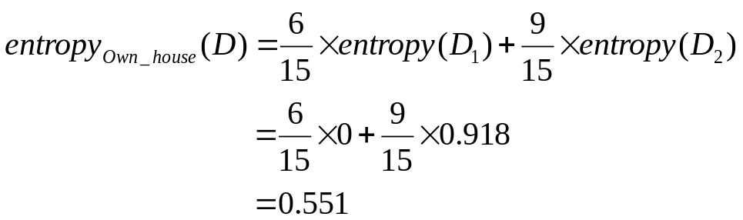
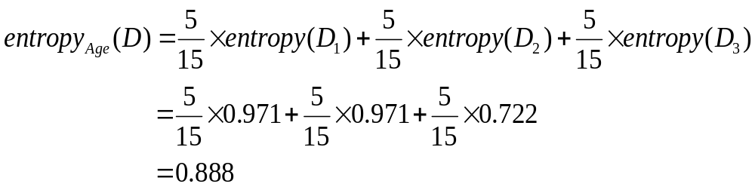
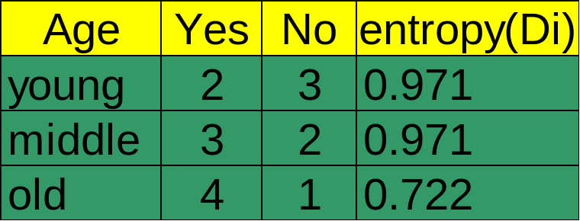

An example
Own_house is the best choice for the root.

Slide 31
We build the final tree
We can use information gain ratio to evaluate the impurity as well.

Slide 32
Handling continuous attributes
Handle continuous attribute by splitting into two intervals (can be more) at each node.
How to find the best threshold to divide?
  Use information gain or gain ratio again
  Sort all the values of an continuous attribute in increasing order {v₁, v₂, …, v_{r}},
  One possible threshold between two adjacent values v_{i} and v_{i+1}. Try all possible thresholds and find the one that maximizes the gain (or gain ratio).

Slide 33
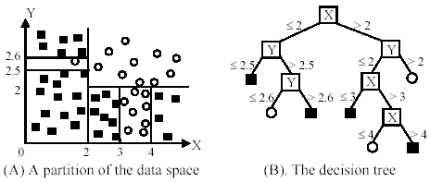
An example in a continuous space

Slide 34
Avoid overfitting in classification
Overfitting: A tree may overfit the training data
  Good accuracy on training data but poor on test data
  Symptoms: tree too deep and too many branches, some may reflect anomalies due to noise or outliers
Two approaches to avoid overfitting
  Pre-pruning: Halt tree construction early
    Difficult to decide because we do not know what may happen subsequently if we keep growing the tree.
  Post-pruning: Remove branches or sub-trees from a “fully grown” tree.
    This method is commonly used. C4.5 uses a statistical method to estimates the errors at each node for pruning.
    A validation set may be used for pruning as well.

Slide 35
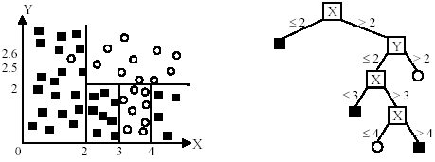
An example
Likely to overfit the data

Slide 36
Other issues in decision tree learning
From tree to rules, and rule pruning
Handling of missing values
Handing skewed distributions
Handling attributes and classes with different costs.
Attribute construction
Etc.

Slide 37

Evaluating classification methods
Predictive accuracy
Efficiency
  time to construct the model
  time to use the model
Robustness: handling noise and missing values
Scalability: efficiency in disk-resident databases
Interpretability:
  understandable and insight provided by the model
Compactness of the model: size of the tree, or the number of rules.

Slide 38
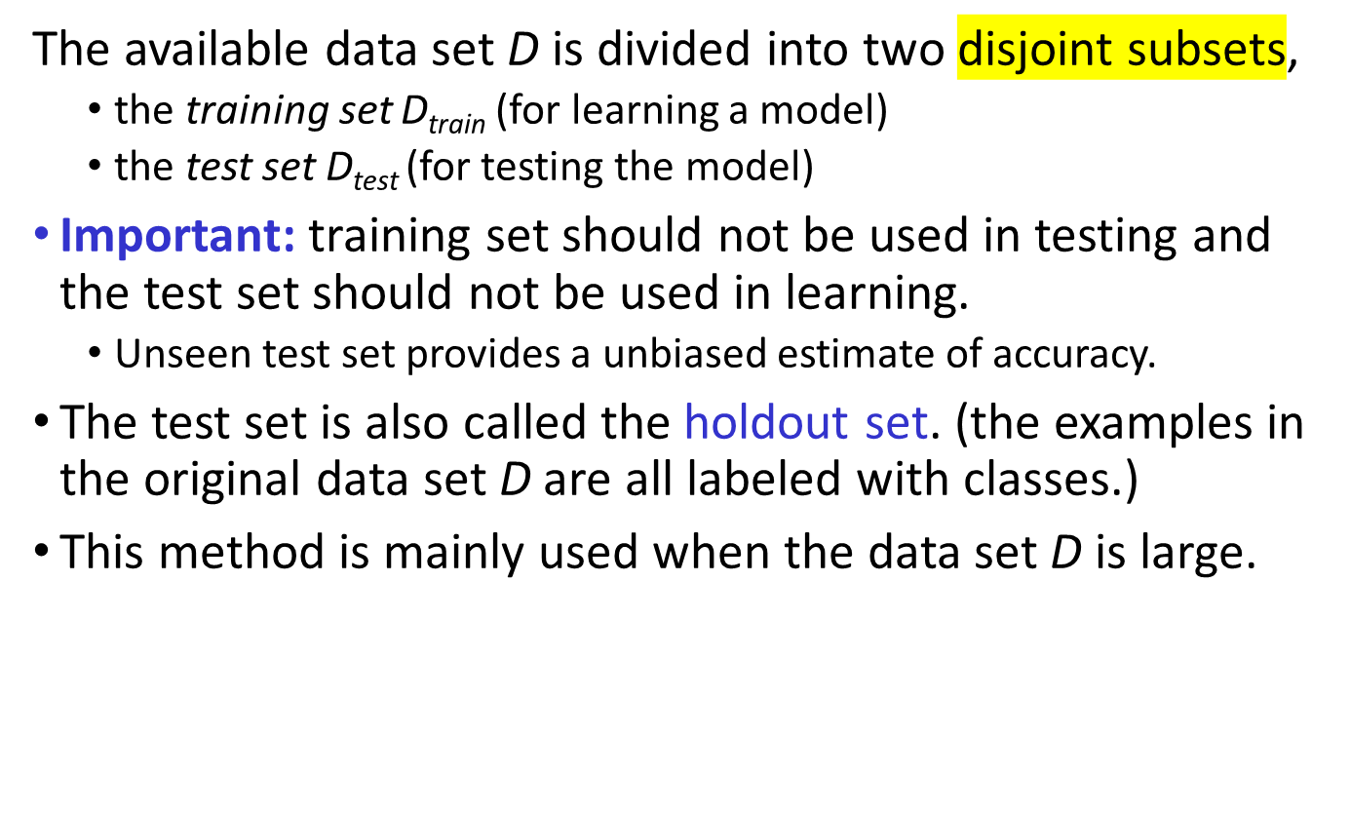
Evaluation methods

Slide 39
Evaluation methods (cont…)
n-fold cross-validation: The available data is partitioned into n equal-size disjoint subsets.
Use each subset as the test set and combine the rest n-1 subsets as the training set to learn a classifier.
The procedure is run n times, which give n accuracies.
The final estimated accuracy of learning is the average of the n accuracies.
10-fold and 5-fold cross-validations are commonly used.
This method is used when the available data is not large.

Slide 40
Evaluation methods (cont…)
Leave-one-out cross-validation: This method is used when the data set is very small.
It is a special case of cross-validation
Each fold of the cross validation has only a single test example and all the rest of the data is used in training.
If the original data has m examples, this is m-fold cross-validation

Slide 41
Evaluation methods (cont…)
Validation set: the available data is divided into three subsets,
  a training set,
  a validation set and
  a test set.
A validation set is used frequently for estimating parameters in learning algorithms.
In such cases, the values that give the best accuracy on the validation set are used as the final parameter values.
Cross-validation can be used for parameter estimating as well.

Slide 42
Classification measures
Accuracy is only one measure (error = 1-accuracy).
Accuracy is not suitable in some applications.
In text mining, we may only be interested in the documents of a particular topic, which are only a small portion of a big document collection.
In classification involving skewed or highly imbalanced data, e.g., network disturbance and financial fraud detections, we are interested only in the minority class.
  High accuracy does not mean any disturbance is detected.
  E.g., 1% intrusion. Achieve 99% accuracy by doing nothing.
The class of interest is commonly called the positive class, and the rest negative classes.

Slide 43
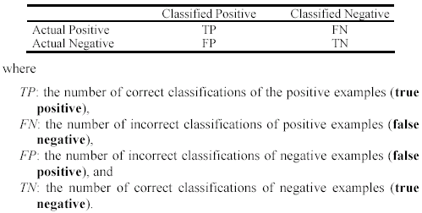
Precision and recall measures
Used in information retrieval and text classification.
We use a confusion matrix to introduce them.

Slide 44

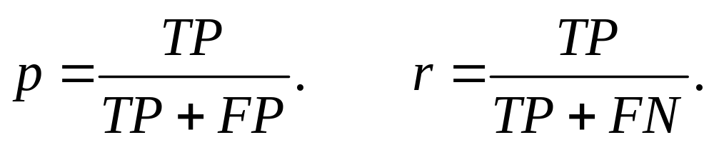
Precision and recall measures (cont…)
Precision p is the number of correctly classified positive examples divided by the total number of examples that are classified as positive.
Recall r is the number of correctly classified actual examples divided by the total number of actual positive examples in the test set.

Slide 45

An example
This confusion matrix gives
  precision p = 100% and
  recall r = 1%
  because we only classified one positive example correctly and no negative examples wrongly.
Note: precision and recall only measure classification on the positive class.

Slide 46
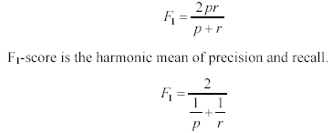
F₁-value (also called F₁-score)
It is hard to compare two classifiers using two measures. F₁ score combines precision and recall into one measure
The harmonic mean of two numbers tends to be closer to the smaller of the two.
For F₁-value to be large, both p and r much be large.

Slide 47


Receive operating characteristics curve
It is commonly called the ROC curve.
It is a plot of the true positive rate (TPR) against the false positive rate (FPR).
True positive rate:
False positive rate:

Slide 48


Sensitivity and Specificity
In statistics, there are two other evaluation measures:
  Sensitivity: Same as TPR
  Specificity: Also called True Negative Rate (TNR)
Then we have

